Slide 1

Used Car Price Prediction Model
CIDM 6355 Project
Picture Source: http://jalk.dvrlists.com/data-mining

Slide 2
Team E
1. Joshua Tarrant | 2. Farzaneh Noroozi
3. Pradnya Bhere | 4. Joshua John
5. Brian Doss | 6. Mallika Alan
7. Trevor Hofmann

Slide 3

Agenda
Introduction
Problem Statement
Data Preprocessing
Feature Selection
Model Building
Model Evaluation
Interpretation

Slide 4
Introduction

Slide 5
Navigating the Complexities of the Used Car Market
The used car market stands as a multifaceted and dynamic sector, critical for a substantial portion of automotive sales. Key to this market is the ability to predict prices accurately — a benefit to sellers and a necessity for buyers to make educated purchases. Our project leverages data mining to unveil patterns and forecast used car valuations. We will delineate the challenges addressed, our data acquisition strategy, and the detailed roadmap of our analytical journey.

Slide 6
Problem Statement

Slide 7
Clarifying the 'Why': The Problem Statement
At the heart of our project lies the quest to demystify the pricing of used cars by dissecting their myriad attributes. Our mission is to craft a tool that enhances decision-making for all market participants. Buyers gain clarity on the valuation impact of each car feature, steering them toward savvy purchasing decisions. Sellers obtain a compass for pricing competitively, bolstering their prospects for transaction success.

Slide 8
Data Description

Slide 9
Dataset Overview: Dissecting the Details
Our analytical expedition utilizes a Kaggle-sourced dataset, rich with insights on pre-owned vehicles. Encompassing 4,009 entries and 12 distinct attributes, our dataset paints a comprehensive picture with variables ranging from make and model to mileage and accident history. These data points converge to inform our target variable: the predicted price range, serving as the cornerstone of our predictive model.

Slide 10
Data Source: Harnessing Kaggle's Repository
The backbone of our project, the used car dataset, is procured from Kaggle—a beacon of data excellence in the realm of data science. For those keen on diving into the data themselves, the dataset is available here: Used Car Price Prediction Dataset for exploration and download. Kaggle's commitment to data integrity and reliability underpins the trustworthiness of our analysis.

Slide 11
Data Cleaning​

Slide 12
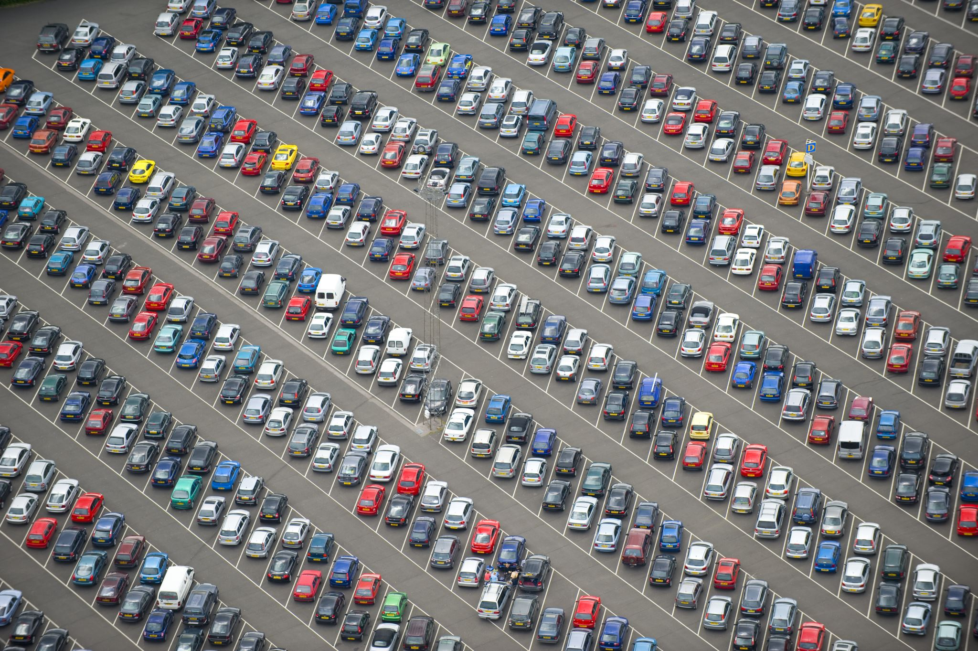
Priming the Data: Preparation Steps​
To ensure the integrity of our analysis, meticulous data preparation was essential.
We:
Excised entries with missing accident data to maintain dataset completeness.
Purged records with placeholder values that obfuscated engine and transmission details.
Substituted 'not supported' engine types with a unifying 'other' category.
Deduced electric vehicle status in the absence of explicit engine type information.
Omitted the 'clean title' field due to indeterminate or missing values, focusing on clear-cut data.

Slide 13
Refining the Dataset: Cleaning Methodology
Our data-cleaning process was driven by the objective to isolate high-value vehicles. Here’s how we refined the data:
Instituted a price threshold at $51,074 to classify vehicles as high-value (1) or not (0), crystallized in the 'HighValueCar' column.
Conducted an exhaustive review of this classification, ensuring it mirrors market realities.
Preserved structural integrity and relevance in our dataset, committing the refined data for subsequent analysis.

Slide 14
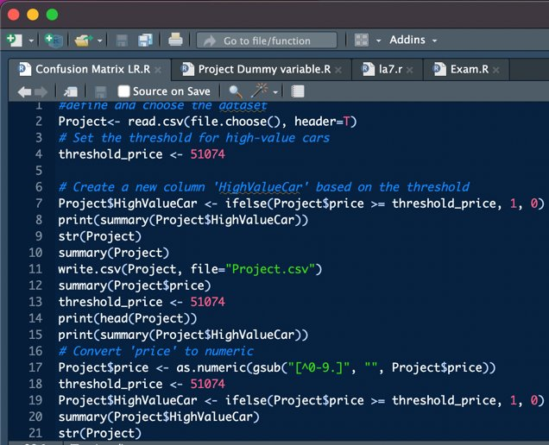
Data Transformation

Slide 15
Data Transformation: Numeric Conversion and Engine Power
Our objective was to streamline the dataset for analytical rigor. This involved:
Converting the 'price' field to a uniform numeric format, ensuring data type consistency.
Addressing non-numeric anomalies in 'engine_power_numeric' by assigning them a null value.
Finalizing this stage with a verification of the data's structure, ensuring readiness for the upcoming analytical processes.

Slide 16
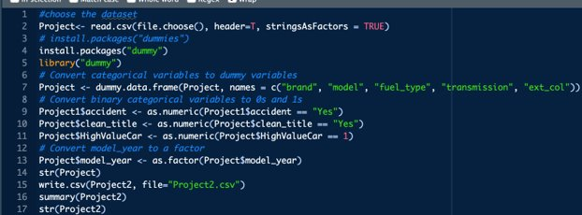
Data Cleaning​

Slide 17
Feature​

Slide 18
Feature Engineering: Dummy Variable Creation
The transformation phase shifted towards categorical variables, where we:
Transmuted categorical fields into dummy variables, enhancing the dataset for machine learning compatibility.
Applied binary encoding to categorical variables, assigning 0 or 1 for simplicity.
Specifically, transformed 'model_year' into a categorical factor to ascertain its predictive power.

Slide 19
Feature​

Slide 20
Feature Optimization: Enhancing Dummy Variable
Delving deeper into feature optimization, our steps included:
Stripping units from 'mileage' and converting it to a numeric scale for uniformity.
Extending the dummy variable strategy to encompass additional categorical fields.
Pruning obsolete categorical columns to refine the dataset's framework.
Culminating this phase with a comprehensive review of the dataset's altered structure

Slide 21
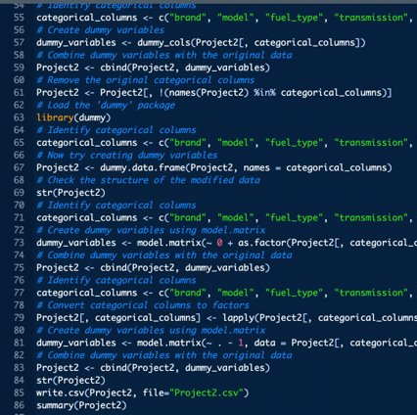
Feature​

Slide 22
Blueprint for Model Building

Slide 23
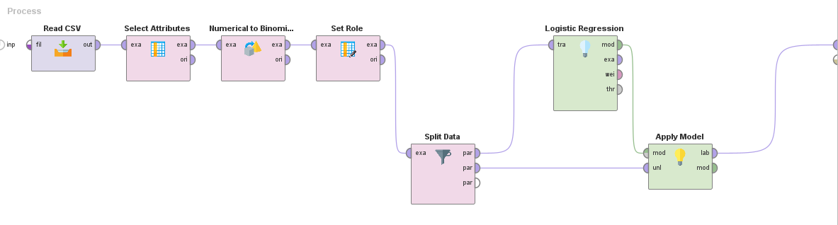
Modeling with Logistic Regression in Rapid Miner
Initiated by importing the dataset to establish our working environment.
Selected pivotal attributes contributing to price prediction.
Transformed numerical variables to fit the logistic regression model.
Designated 'HighValueCar' as our prediction target.
Partitioned the dataset into a 70/30 split for training and testing.
Developed a logistic regression model to estimate the probability of a car being high-value.
Validated the model with the test set and captured the performance metrics.

Slide 24
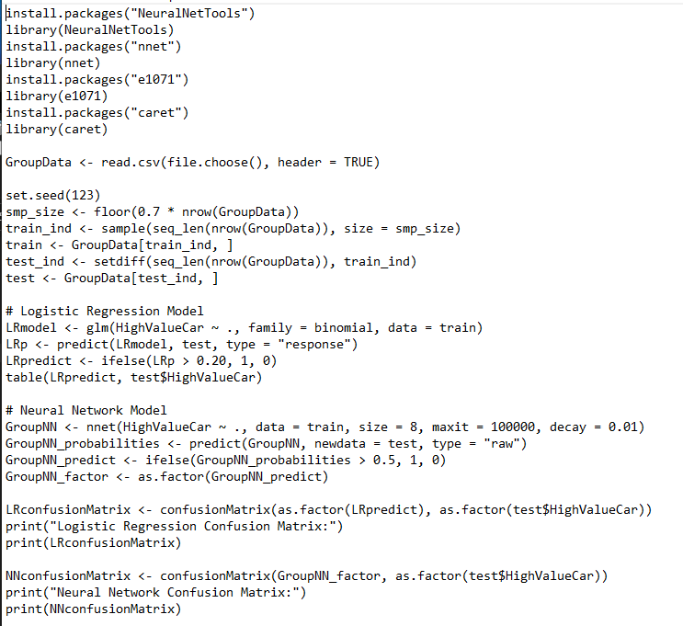
Logistic Regression Analysis in RStudio
Loaded the dataset in RStudio, prepping for analysis.
Conducted data type conformity checks and adjustments.
Created training and validation subsets adhering to a 70/30 ratio.
Employed a logistic regression algorithm targeting 'HighValueCar' classification.
Implemented the model, followed by a critical evaluation using a confusion matrix.
The output revealed key insights into model accuracy and predictive capability.

Slide 25
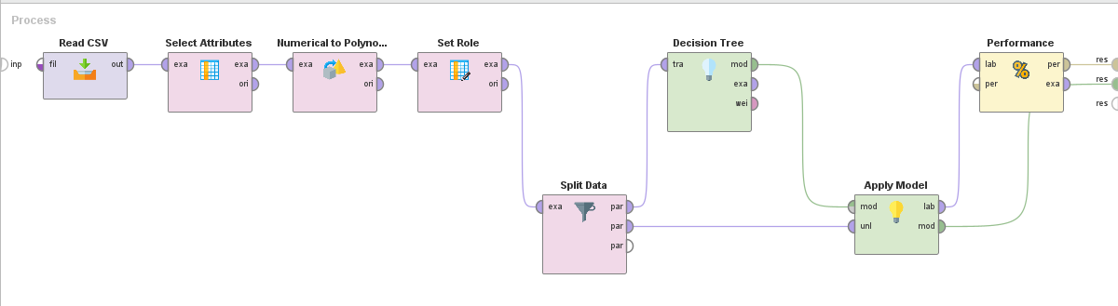
Decision Tree Construction in Rapid Miner
Imported the cleaned dataset ready for modeling.
Executed attribute selection to fine-tune the input variables.
Configured the 'HighValueCar' role for outcome prediction.
Executed a 70/30 data split for a balanced training and testing approach.
Developed a decision tree model to decipher the rules governing car values.
Applied the model to the test set, analyzing the decision logic and accuracy.

Slide 26
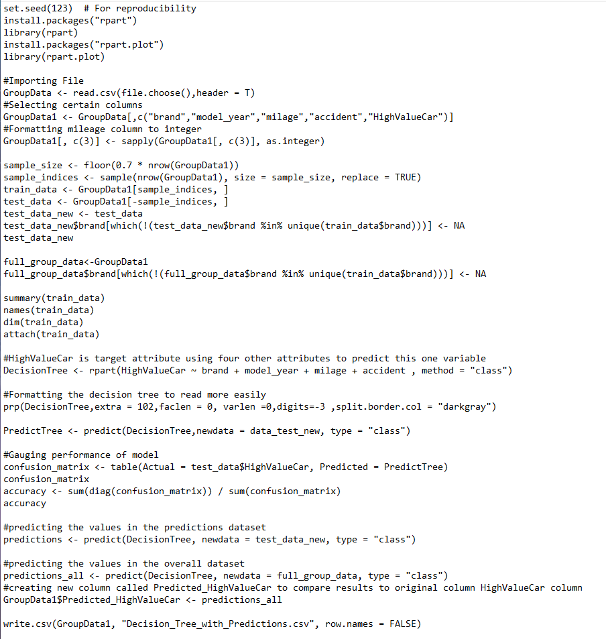
Crafting Decision Trees in RStudio
Prepared the environment by loading essential packages and the dataset.
Segregated the data into training and test sets for model validation.
Generated a decision tree to classify cars based on their features.
Evaluated the model's performance with accuracy metrics and a confusion matrix.
Exported the final model results for further examination and reporting.

Slide 27
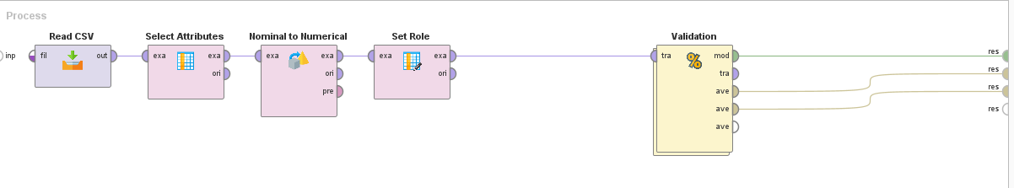
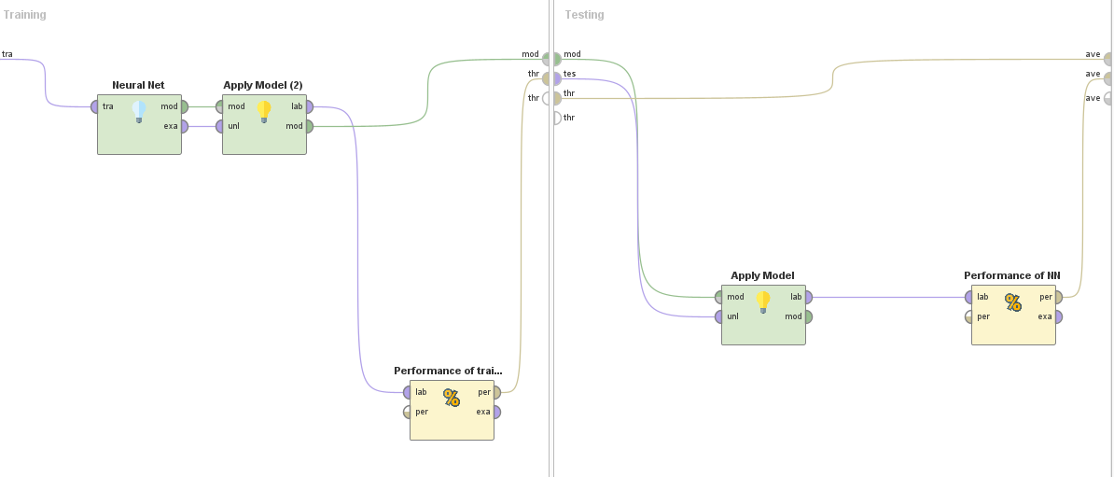
Neural Network Modeling in Rapid Miner
Commenced with dataset importation and variable selection.
Preprocessed numerical inputs for neural network suitability.
Set the prediction goal for the 'HighValueCar' variable.
Executed model validation runs to ensure robustness.
Constructed a neural network model to capture non-linear patterns.
Assessed model efficacy through performance measurement.

Slide 28
Neural Networks Deployment in RStudio
Installed and loaded necessary libraries for neural network modeling.
Curated training and test datasets to feed into the neural network.
Crafted a neural network model to learn from the complex interplay of attributes.
The model was then applied, and its predictive accuracy was detailed through a confusion matrix.

Slide 29
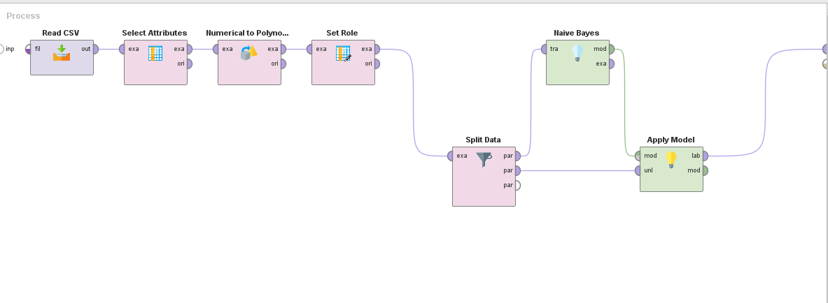
Naïve Bayes Classification in Rapid Miner
Initiated with CSV import and attribute selection specific to Naïve Bayes.
Preprocessed data to meet Naïve Bayes model requirements.
Conducted a 70/30 data split to balance training and validation.
Created a Naïve Bayes model to probabilistically predict car value categories.
Application of the model was followed by a detailed analysis of prediction outcomes.

Slide 30
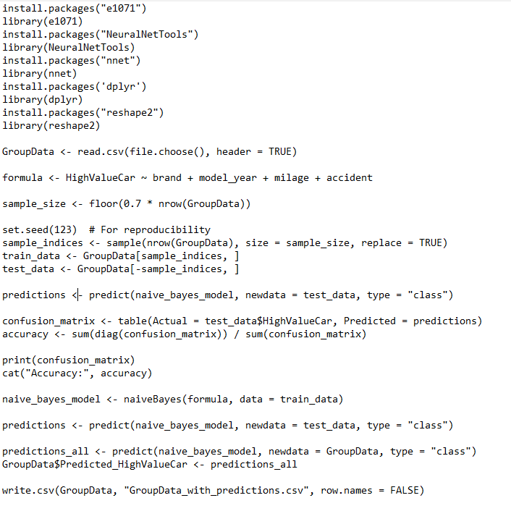
Implementing Naïve Bayes in RStudio
Loaded the dataset and prepared the R environment with relevant packages.
Converted categorical variables to factors suitable for Naïve Bayes analysis.
Developed the Naïve Bayes model, emphasizing its simplicity and probabilistic nature.
Tested the model's prowess and documented findings through exportable CSV files.

Slide 31
Model Performance Metrics

Slide 32
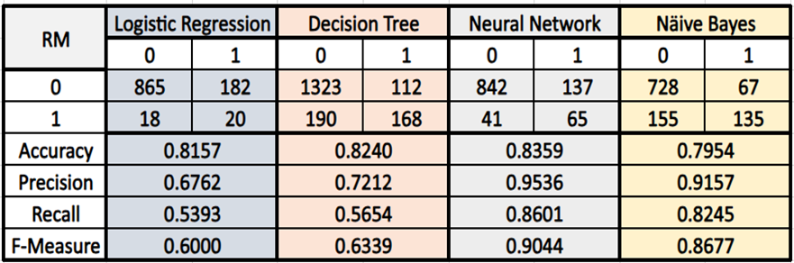
In-Depth Model Performance Analysis
Decision Tree Insights:
R: Accurate with signs of overfitting, precision-recall trade-off notable.
RapidMiner: Better recall, suggesting improved model generalization.
R | Logistic Regression |  | Decision Tree |  | Neural Network |  | Näive Bayes
 | 0 | 1 | 0 | 1 | 0 | 1 | 0 | 1
0 | 866 | 7 | 1323 | 112 | 1188 | 247 | 2056 | 11
1 | 10 | 203 | 190 | 168 | 94 | 264 | 13 | 452
Accuracy | 0.8039 |  | 0.8316 |  | 0.8098 |  | 0.9905
Precision | 0.9886 |  | 0.6000 |  | 0.8279 |  | 0.9947
Recall | 0.9920 |  | 0.4693 |  | 0.9267 |  | 0.9937
F-Measure | 0.9903 |  | 0.5267 |  | 0.8745 |  | 0.9942
Logistic Regression Insights:
R: Highly precise, excellent recall, indicative of a well-fitted model.
RapidMiner: Balanced performance, potential for refinement in precision and recall.

Slide 33
In-Depth Model Performance Analysis
Naive Bayes Insights:
The standout model with near-perfect metrics, showing robustness in both R and RapidMiner.
High precision and recall suggest excellent model fit and generalization.
R | Logistic Regression |  | Decision Tree |  | Neural Network |  | Näive Bayes
 | 0 | 1 | 0 | 1 | 0 | 1 | 0 | 1
0 | 866 | 7 | 1323 | 112 | 1188 | 247 | 2056 | 11
1 | 10 | 203 | 190 | 168 | 94 | 264 | 13 | 452
Accuracy | 0.8039 |  | 0.8316 |  | 0.8098 |  | 0.9905
Precision | 0.9886 |  | 0.6000 |  | 0.8279 |  | 0.9947
Recall | 0.9920 |  | 0.4693 |  | 0.9267 |  | 0.9937
F-Measure | 0.9903 |  | 0.5267 |  | 0.8745 |  | 0.9942
Neural Network Insights:
Strong performance with high recall, capturing the majority of high-value car instances.
R: Slightly better precision, indicating a well-tuned model.

Slide 34

Model Performance - Summary
Across all models, Naive Bayes emerges as the leader in performance, with Logistic Regression and Neural Networks also showing strong capabilities. Decision Trees, while accurate, may require further tuning to address overfitting as indicated by the precision-recall trade-off.

Slide 35
Conclusion & Way Forward

Slide 36
Conclusion & Future Directions
Project Summary:
Demonstrated promising capabilities in predicting used car prices with actionable insights for stakeholders.
Evaluation techniques established the viability of predictive models for practical use.
Implications for Stakeholders:
Car dealerships, buyers, and sellers can leverage these models for better pricing strategies and decision-making.
Study Limitations:
Acknowledge potential data gaps and the static nature of the current models, with a note on market dynamics.
Recommendations for Enhancement:
Suggest the collection of a more comprehensive dataset for improved model accuracy.
Propose the integration of advanced modeling techniques and external economic factors for refined predictions.
Closing Note:
The Used Car Price Prediction Project is poised to be an instrumental tool for the automotive industry, fostering data-driven decision-making.

Slide 37
End

Slide 38
Appendix

Slide 39
Presentation Recording: Zoom Link
https://us02web.zoom.us/rec/share/4H__PjyeQ6nvNS9iGfJUEa_Tp6sfl_kpzGpV_26SL9l-SwcXgJDEHccxWw26rZMA.qqlIrHV3CbUprLc8?startTime=1700529691000
Passcode: h&m1T.6J

